Slide 1

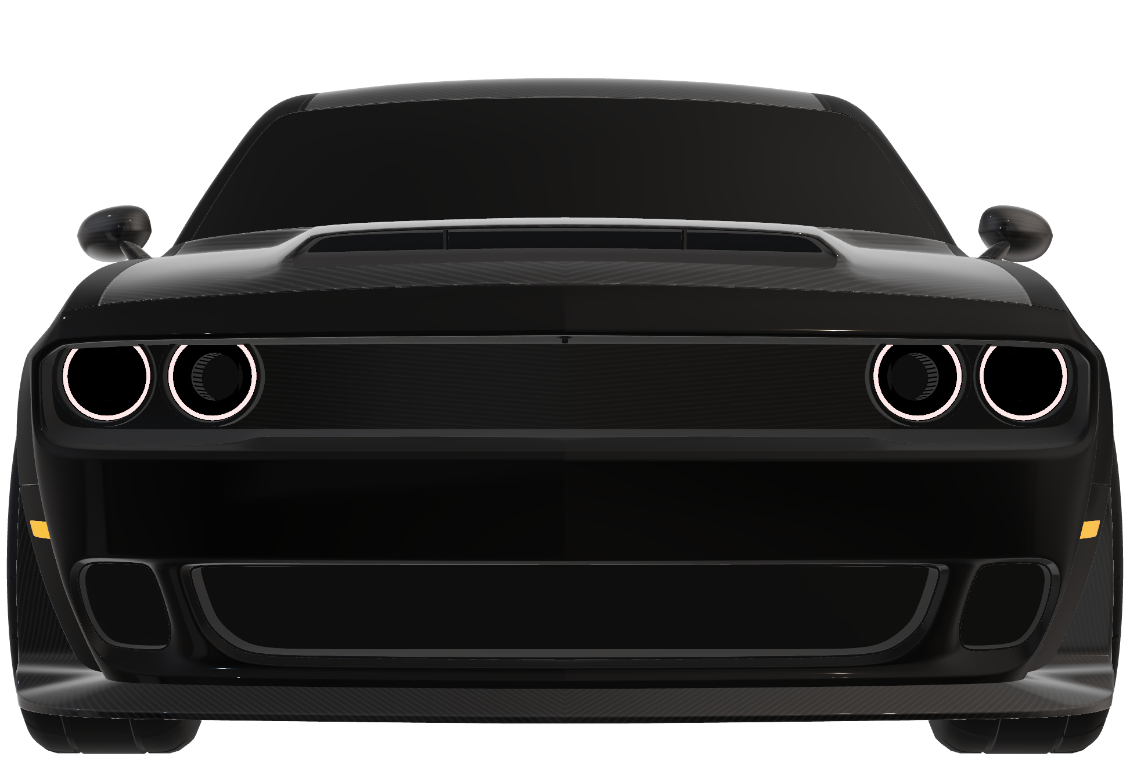
DODGE CHELLENGER
STAYING TRUE TO OUR ROOTS BY DISPLAYING WORLD-CLASS PERFORMANCE AND DODGE BRAND MUSCLE, THE CHALLENGER ISN’T AFRAID TO CROSS ANY LINE IT STANDS IN FRONT OF
492
л.с.
6,4
л объем
4,4
сек разгон

Slide 2
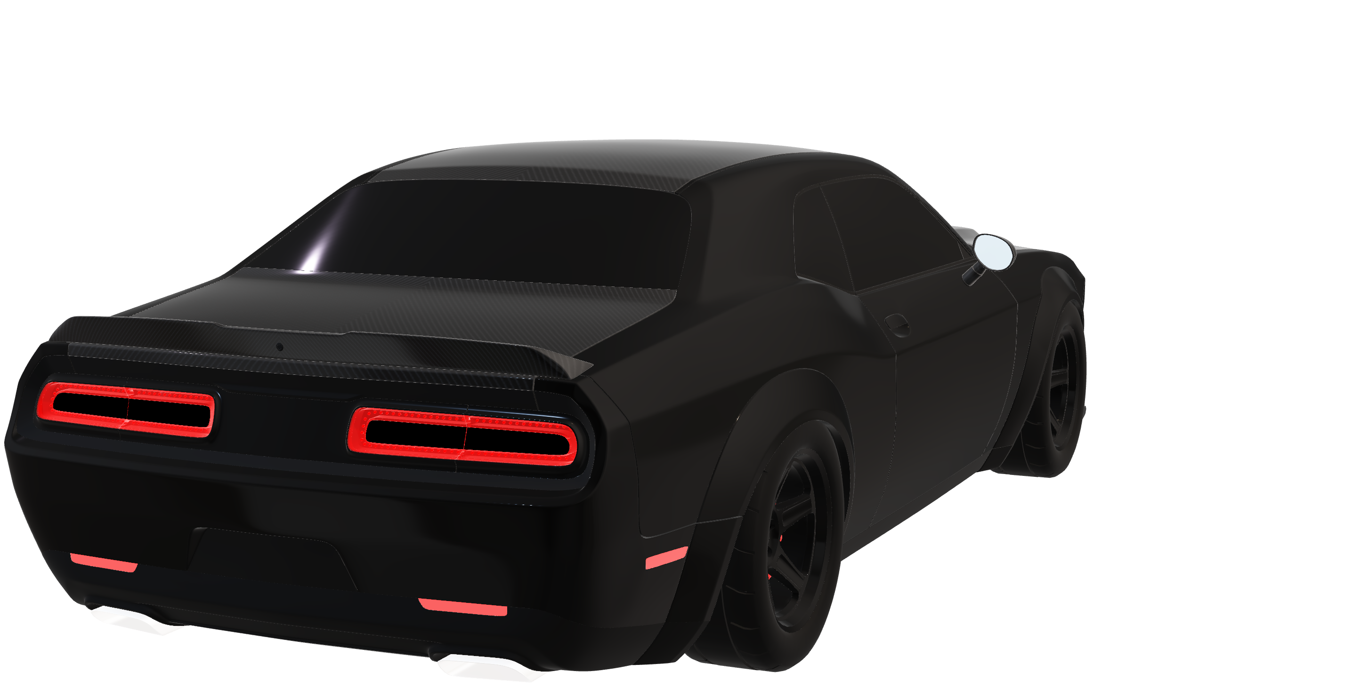
DODGE CHELLENGER
STAYING TRUE TO OUR ROOTS BY DISPLAYING WORLD-CLASS PERFORMANCE AND DODGE BRAND MUSCLE, THE CHALLENGER ISN’T AFRAID TO CROSS ANY LINE IT STANDS IN FRONT OF
492
6,4
4,4
л.с.
л объем
сек разгон

Slide 3
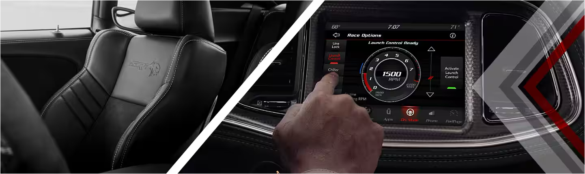
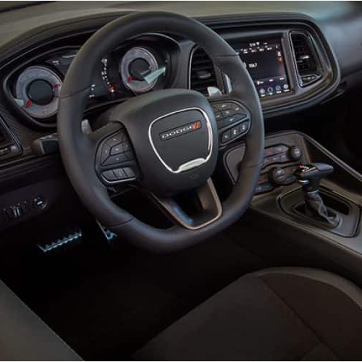
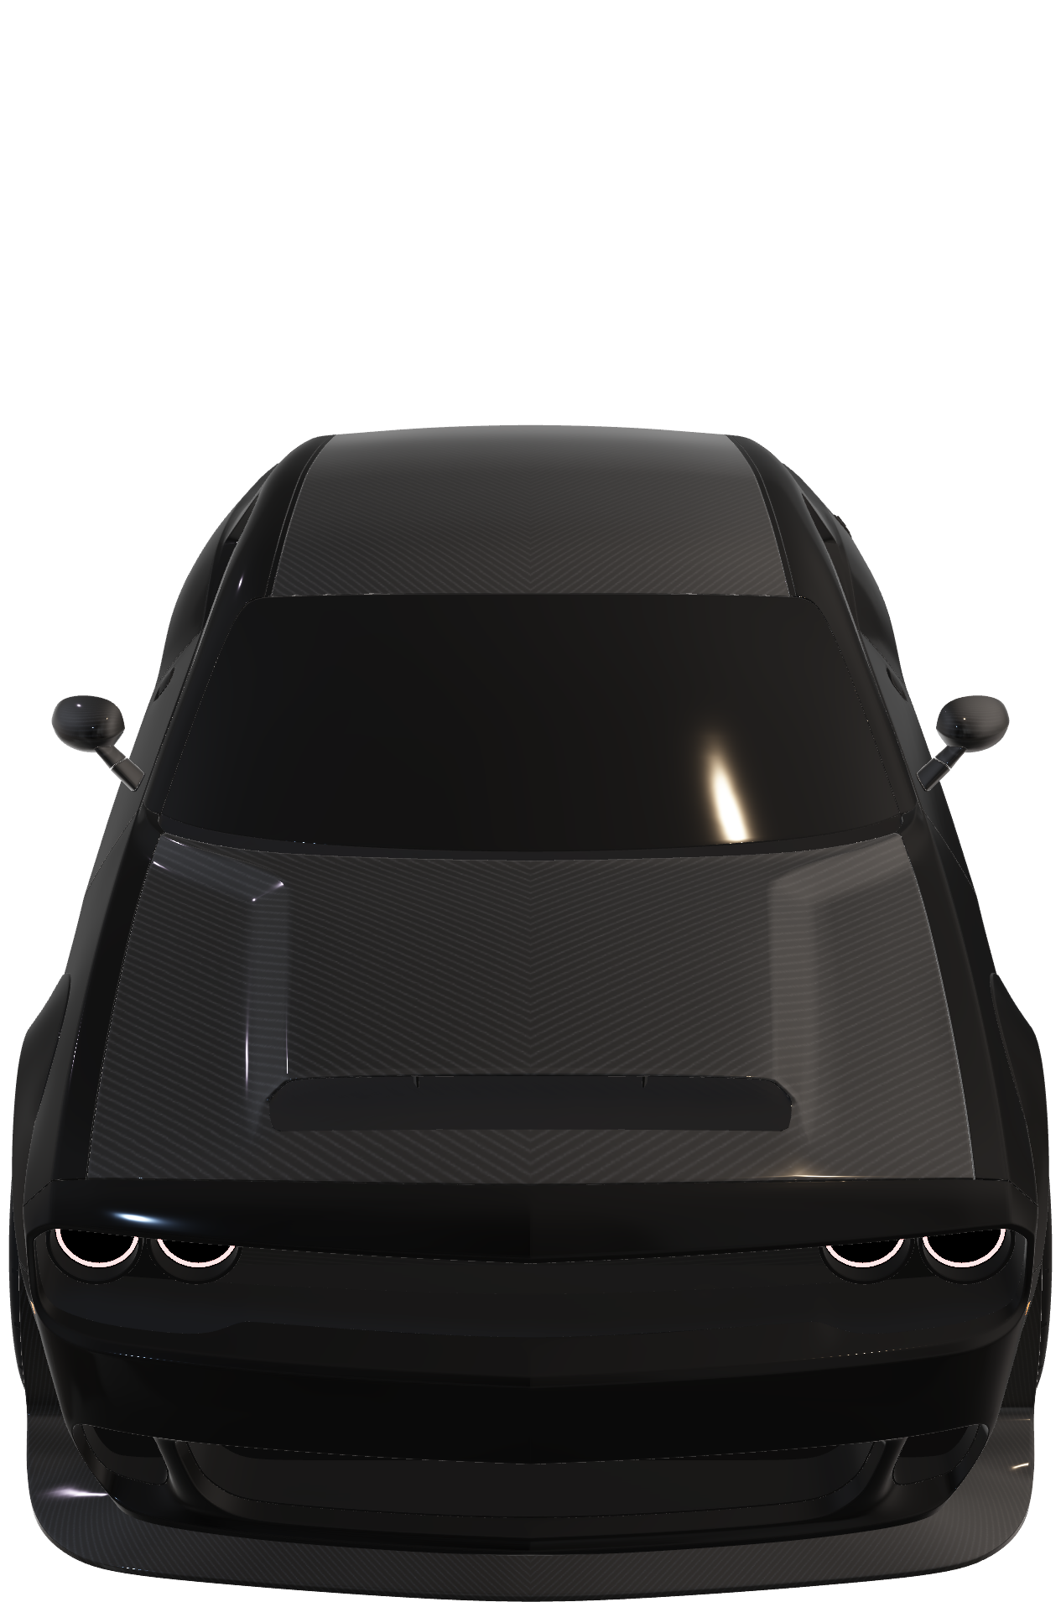
THE 2023 DODGE CHALLENGER RULES THE ROAD INSIDE AND OUT, FEATURING THE LARGEST AVAILABLE TOUCHSCREEN RADIO IN ITS CLASS AT 8.4 INCHES
AND CLASS-EXCLUSIVE FIVE-PASSENGER SEATING
BORN
POWERFUL
Leading from the front of the pack, the Dodge Challenger SRT® Super Stock flaunt
the highest horsepower of any production car, coming in at a whopping 807 ponies

Slide 4

THE 2023 DODGE CHALLENGER RULES THE ROAD INSIDE AND OUT, FEATURING THE LARGEST AVAILABLE TOUCHSCREEN RADIO IN ITS CLASS AT 8.4 INCHES
AND CLASS-EXCLUSIVE FIVE-PASSENGER SEATING
BORN
POWERFUL
Leading from the front of the pack, the Dodge Challenger SRT® Super Stock flaunt
the highest horsepower of any production car, coming in at a whopping 807 ponies

